Slide 1
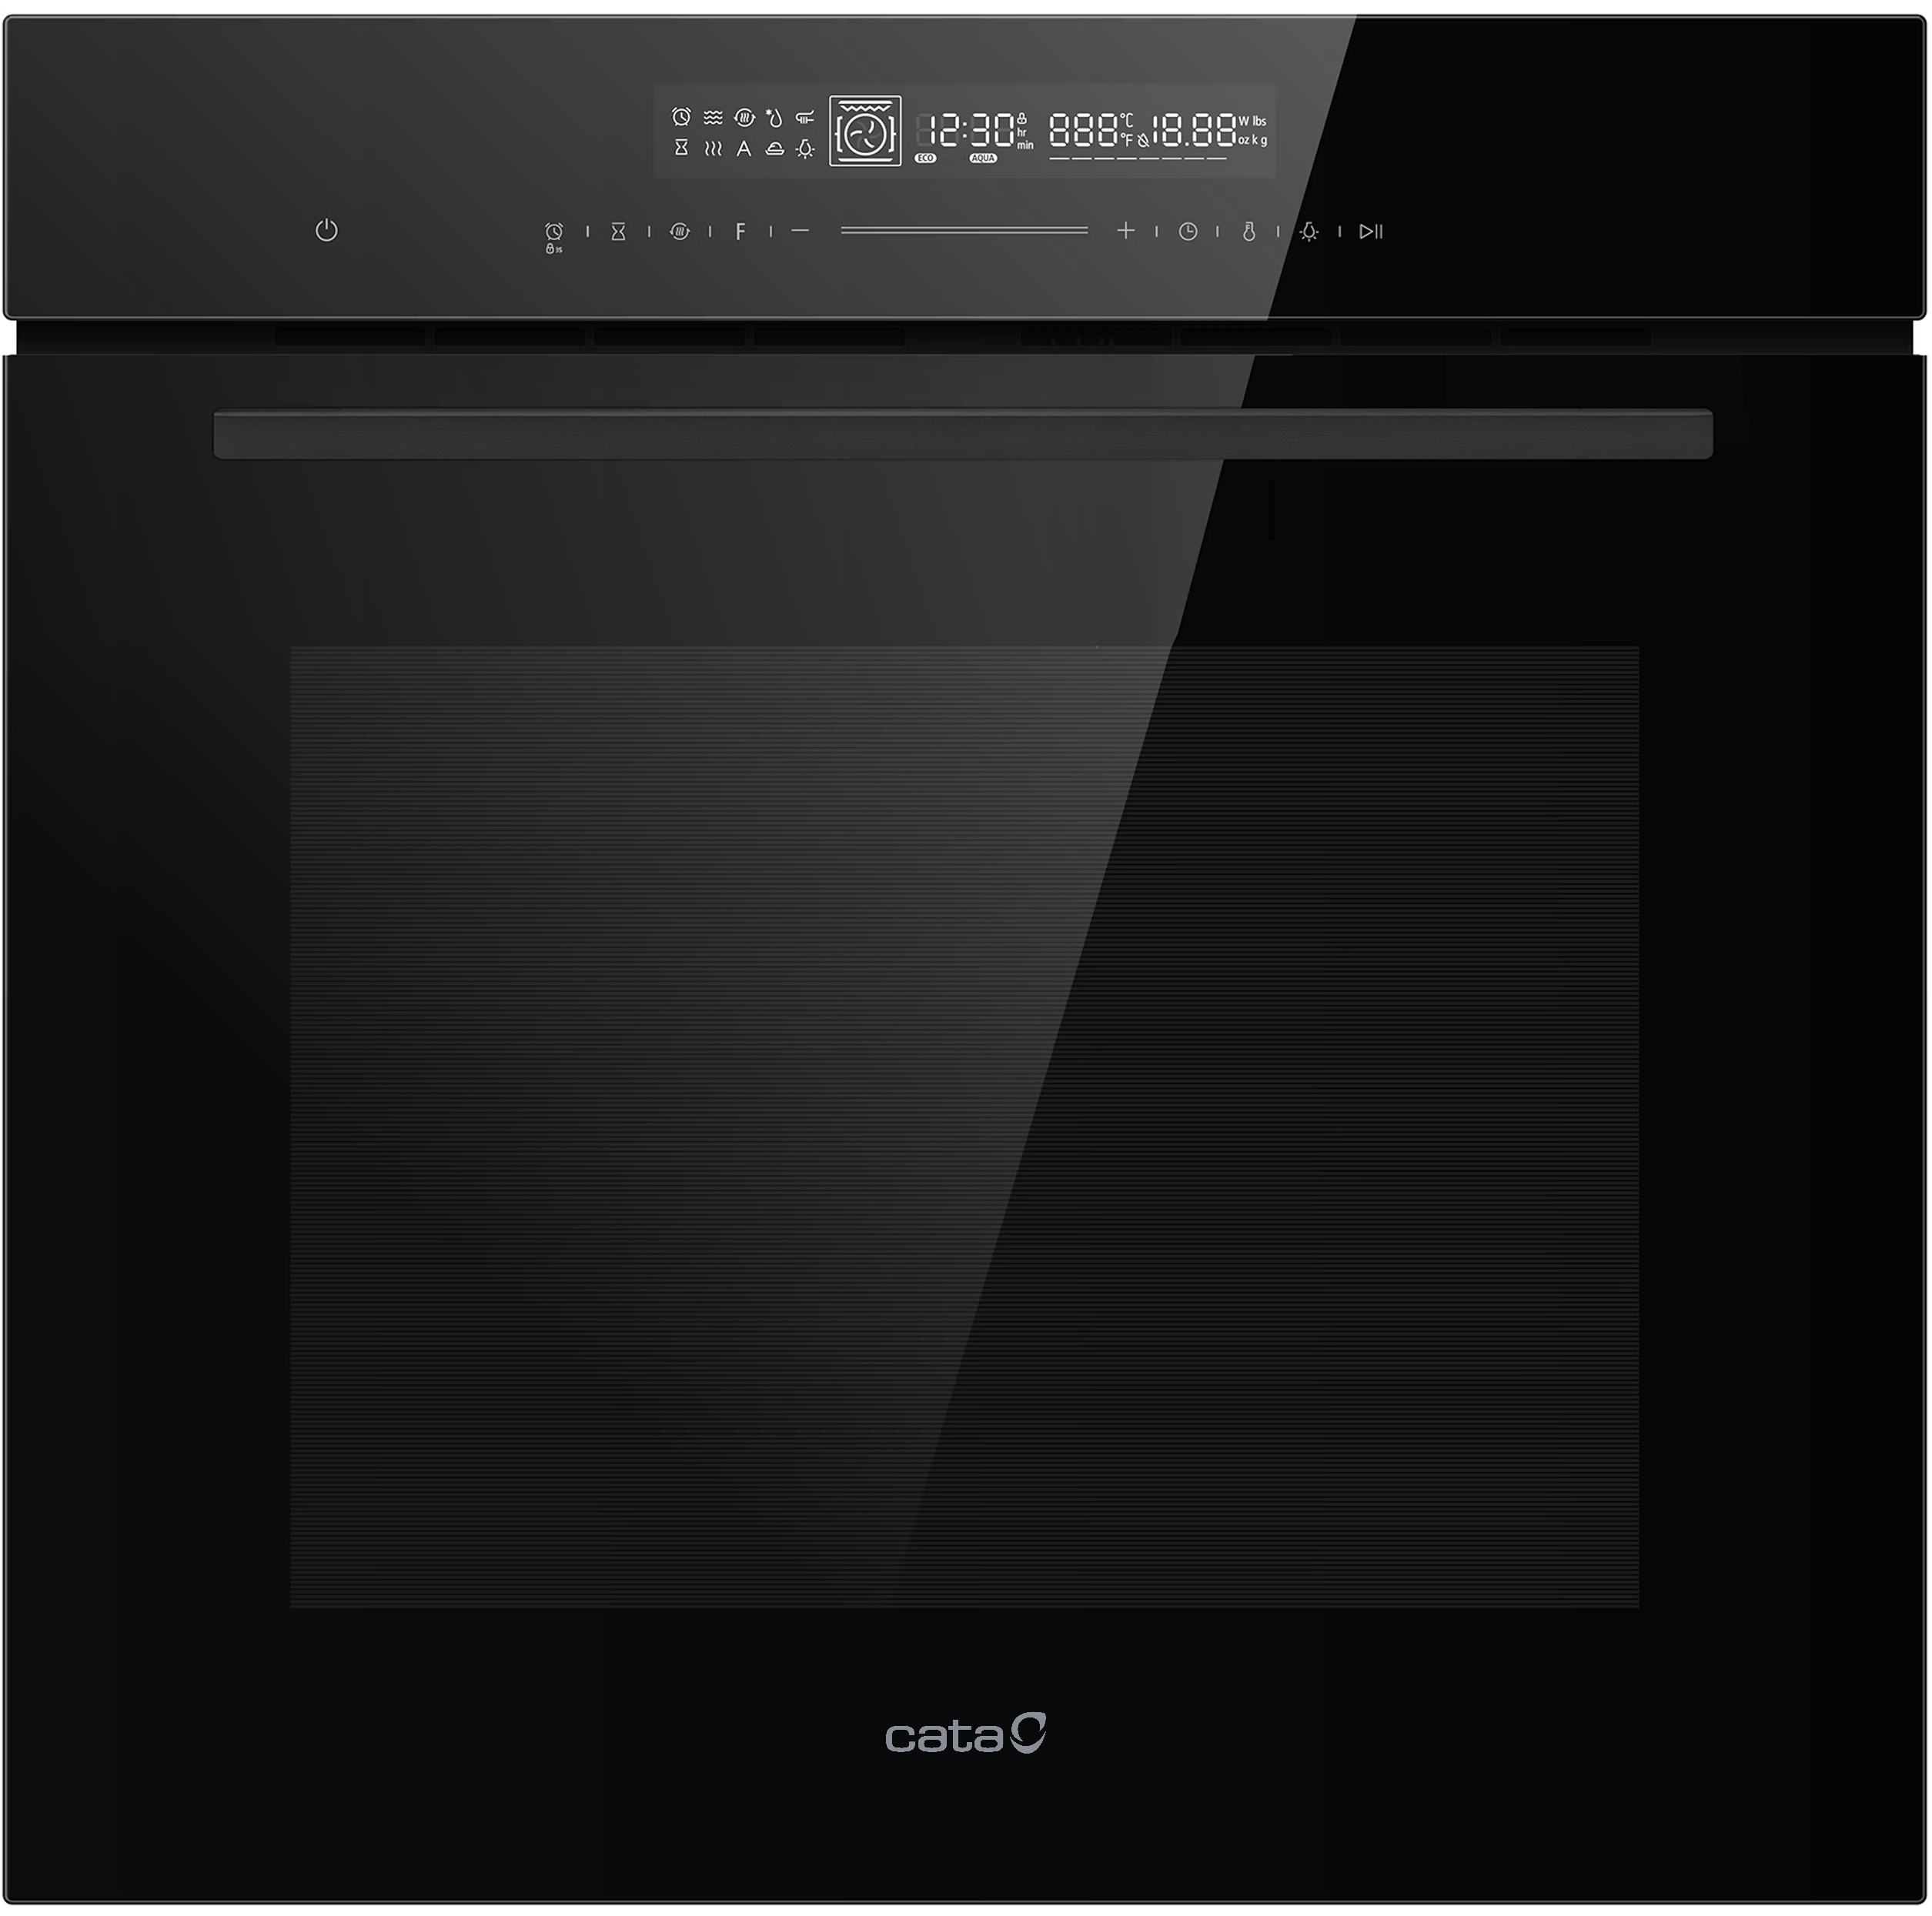














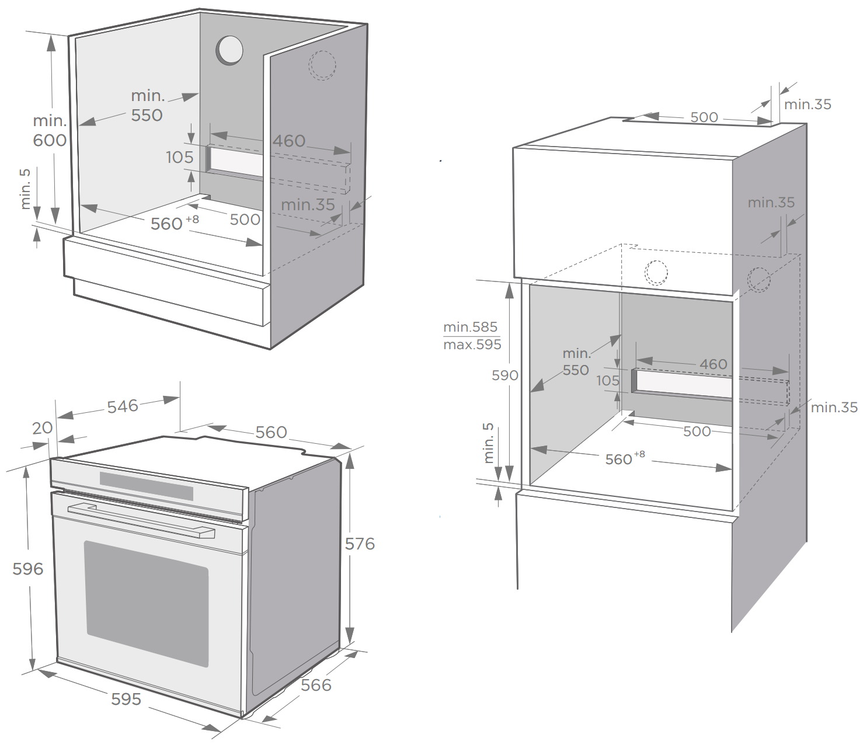
CAT72MFBK
60CM BUILT-IN MULTIFUNCTION OVEN
Main Features
Brand | Cata
Oven | Multifunction
Heat Source | Electric
Colour / Finish | Black
Capacity (net) | 72L
No. of Functions | 13
User Controls | Full Touch with LED Display
Characteristics
Oven Type | True Fan with Grill
Door Colour | Black Glass
Door Handle | Black Aluminium
Control Panel | Black Glass
Display Colour | White
Clock Timer | Full Programmer
Oven Cavity Finish | Easy Clean Black Enamel
Oven Cleaning | Manual
Shelf Positions | 5
Oven Lights | 2
Cooking Modes | Defrost, Rapid Pre-heat, Pizza, Sabbath, Pause, Fermentation
Door Opening | Drop Down
No. of Door Layers | Triple Glazed
Soft Close | -
Safety | Child-Lock, Cooling Fan, Safety Shutoff
EAN
8422248617833
Supplied Accessories
Shelf Racks | Chrome Rails
Oven Shelves | 1
Oven Liners | -
Telescopic Rail Set | 1x 100% Extension
Oven Tray | Yes, Deep
Grill Trivet | Yes
Technical Data
Rated Voltage | 220-240V ~ 50/60Hz
Max Power | 2900W
Supply Connection | 13A
Cable / Plug | 1.5m / -
Energy Efficiency Class | A+
Energy consumption, conventional | 1.06 kWh/cycle
Energy consumption, fan-forced | 0.69 kWh/cycle
Dimensions & Weights
Product (WxHxD) | 595 x 596 x 566 mm
Built-In Niche (WxHxD) | 560 x 590 x 550 mm
Packed Product (WxHxD) | 720 x 670 x 650 mm
Net Weight | 35.0 kg
Gross Weight | 39.0 kg

